Slide 1

Section 11.6 Absolute Convergence and the Ratio and Root Tests
Lecture 2
Ratio and Root Tests

Slide 2
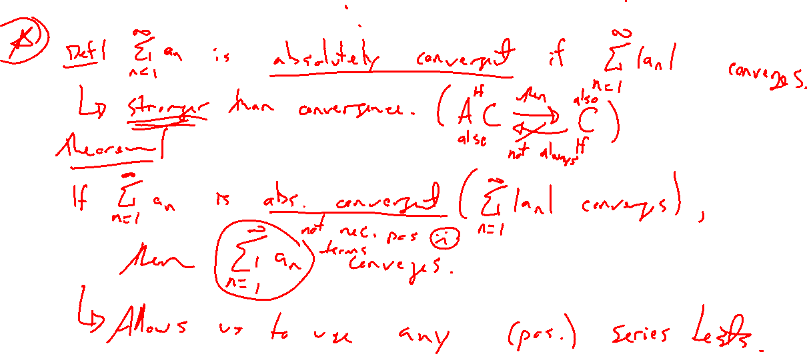
Reminder: Absolute Convergence
Notes:
Def
Theorem
Gives access to other series tests

Slide 3
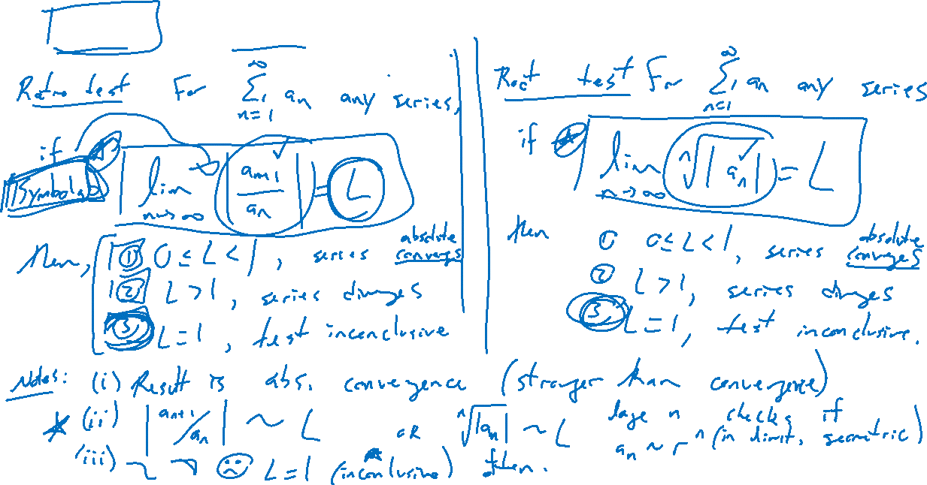
Ratio and Root Tests
Notes:
Place side-by-side for \sum a_n
Ratio: \lim |a_{n+1}/a_n| = L
Root: \lim \sqrt[n]{|a_n|} = L
If L < 1, abs convergent, if L=1, inconclusive, if L>1,\infty, divergent
Notes: Why works? Reminds of geom series. Checking if a_n ~ L^n for n large
Result stronger than usual, get abs convergence
Often inconclusive

Slide 4
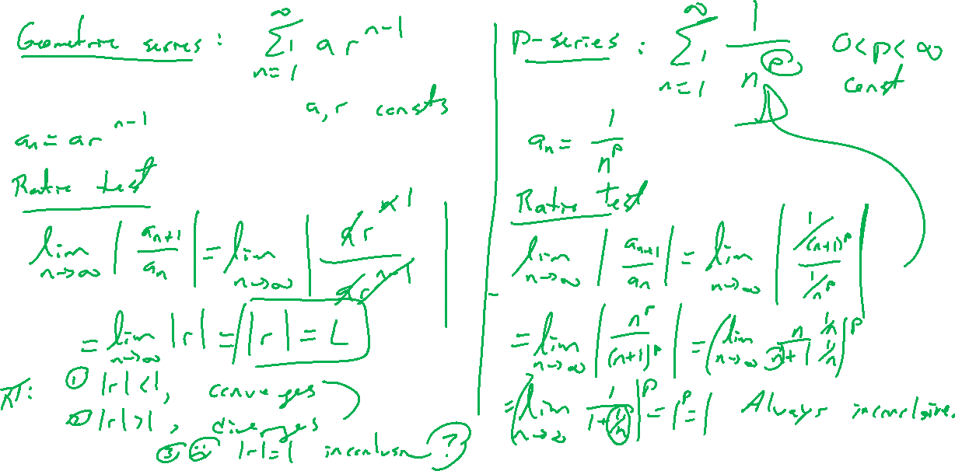
Examples: Familiar Series
Notes:
Try both for each.
Geom series: root test, inconclusive for r=1
p-series: ratio test, inconclusive for any p
Summarize what to look for

Slide 5
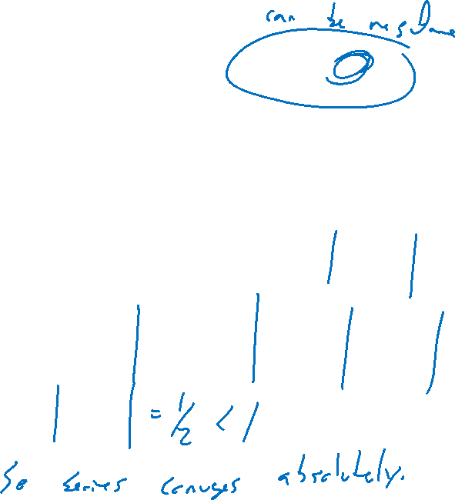
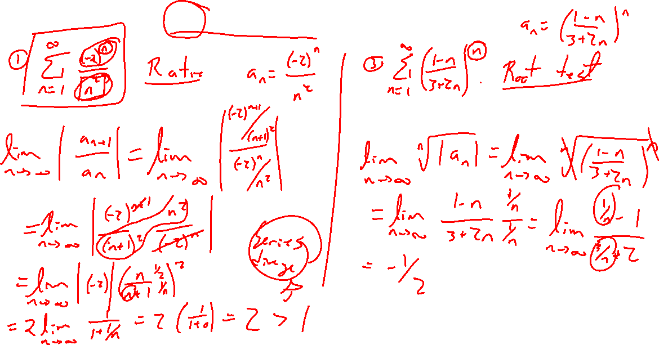
Examples: Try on Own
Notes:
First figure which test
Ratio test: (-2)^n/(n^2) ; 1/n! (goes to e)
Root test: ((1-n)/(3+2n))^n (geom series in limit)
Bonus: n/sqrt{n^3+2}

Slide 6
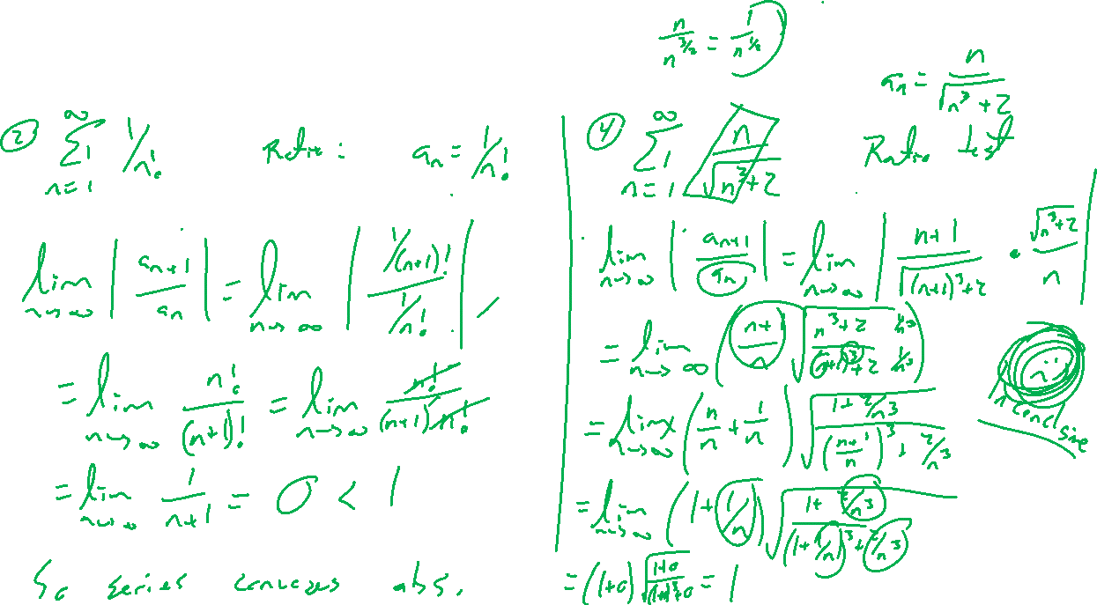
Examples: Try on Own
Notes:
First figure which test
Ratio test: (-2)^n/(n^2) ; 1/n! (goes to e)
Root test: ((1-n)/(3+2n))^n (geom series in limit)
Bonus: n/sqrt{n^3+2}

Slide 7

Section 11.6 Examples and Homework
Rework textbook examples: 1, 3, 4, 5, 6
Write down problem.
Close book and attempt on own.
Compare your solution to text solution, improve your writing.
Exercises: 3, 9, 25, 31, 33

Slide 8

Section Homework Submission to Canvas
Preview of section​
Skim section, write short paragraph summary, list all important definitions / theorems / formulas.​
Notes on video lectures​
Include all details, worked examples, your own thoughts​
Worked examples from text​
Solutions to exercises​
Final reflection of section​
List of key takeaways to remember​

